Slide 1



Renewable Energy
Omdena- Nigerian Chapter
Data Visualization

Slide 2

Overview
Tasks goals
Understanding the data
Choosing the best form representation for the data
Create an Interactive visualization platform for selected data and model result

Slide 3
StreamLit
Streamlit is a Python-based library that allows data scientists to easily create free machine learning applications. You can easily read in a saved model and interact with it with an intuitive and user friendly interface.
Guide to Streamlit
Create a data explorer app—Streamlit 0.87.0 documentation. (n.d.). Retrieved August 26, 2021, from https://docs.streamlit.io/en/stable/tutorial/create_a_data_explorer_app.html
Evgeniia. (2021, March 23). Web Application in 10 minutes with Streamlit. Analytics Vidhya. https://medium.com/analytics-vidhya/web-application-in-10-minutes-with-streamlit-99685e3350e0
Mashinchi, N. (2021, March 17). A quick tutorial on how to deploy your Streamlit app to Heroku. Medium. https://towardsdatascience.com/a-quick-tutorial-on-how-to-deploy-your-streamlit-app-to-heroku-874e1250dadd

Slide 4
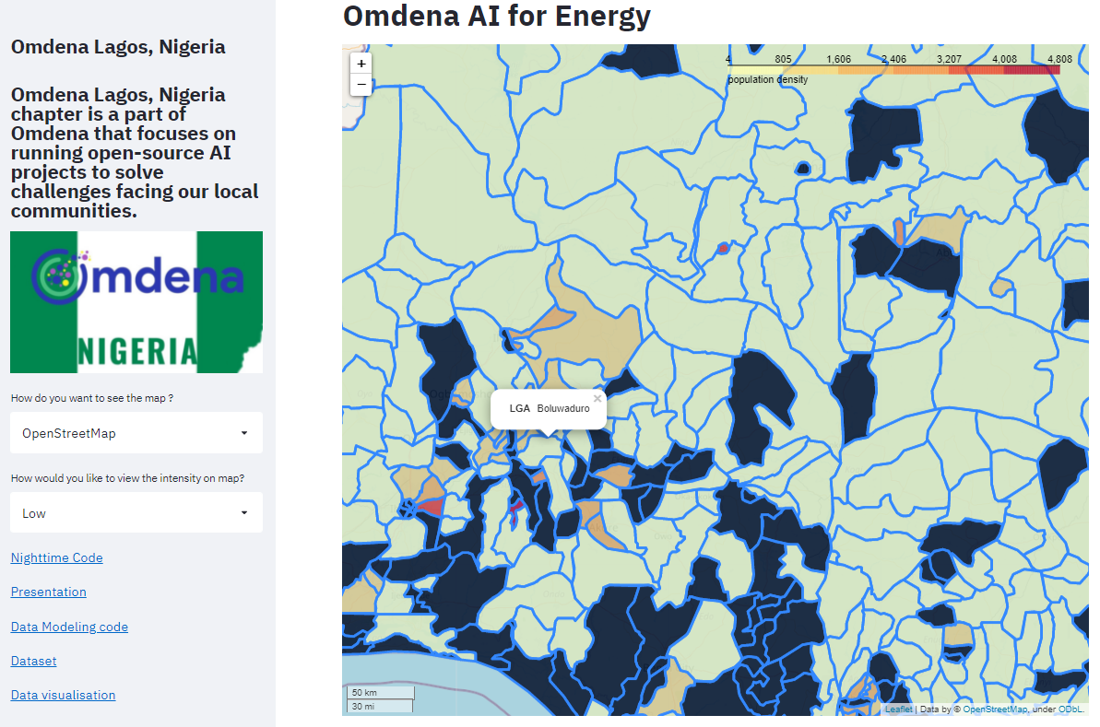
Map Visualization of Population and Energy Intensity

Slide 5
Supplementary Links
Data from Night time Mask
Estimate of Energy Demand

Slide 6
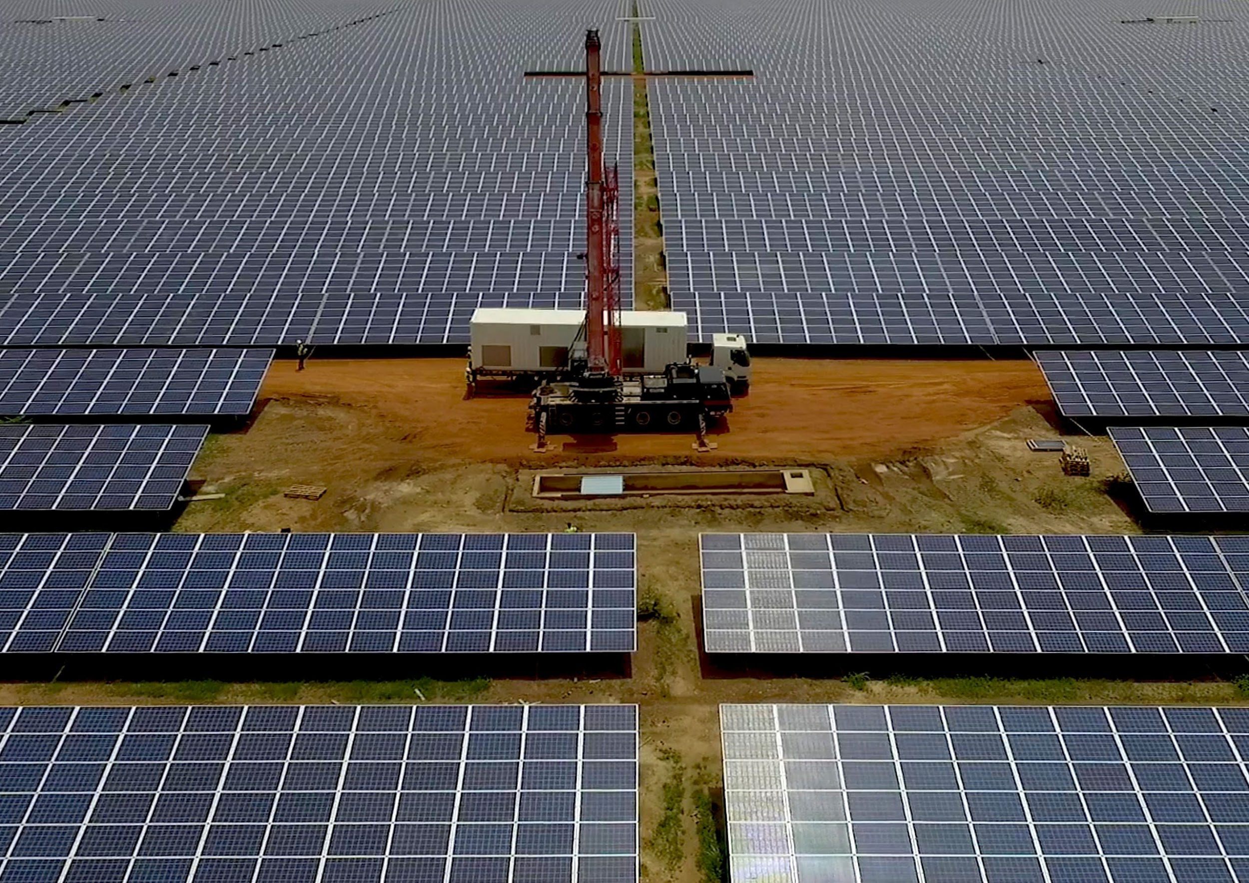
Thank you for your attention

